Slide 1
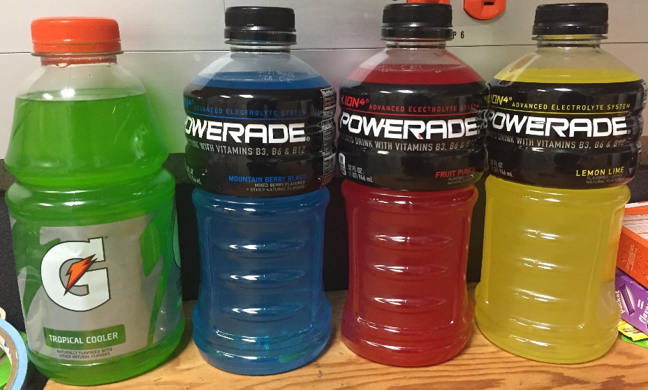
FD&C Dye Content of Popular Children’s Beverages
What is an FD&C dye?
Why quantify them?
How to quantify
Results

Slide 2
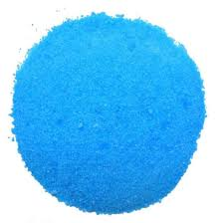
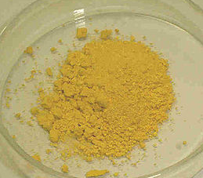
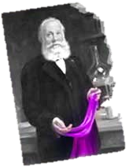
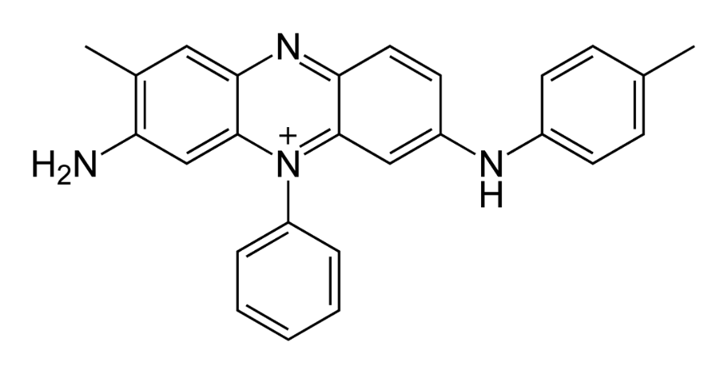
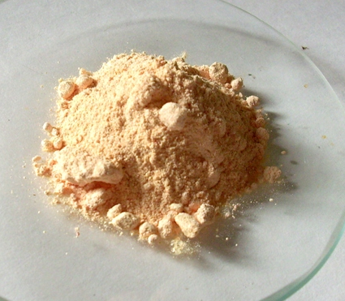
A Brief History of Food Coloring
First century – smoke and aloe in wine
PbCrO₄ in milk
PbO₂ in bread
CuSO₄ in tea
Notes:
Pictures are public domain

Slide 3
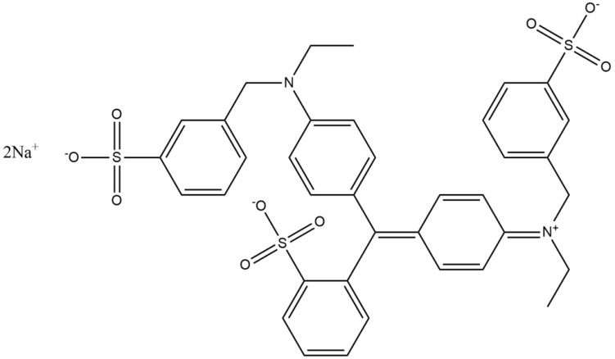
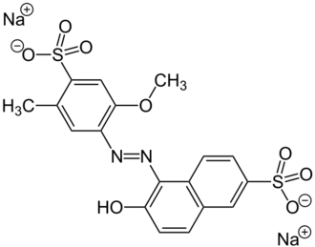
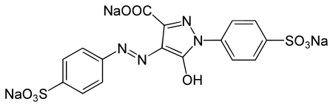
What is an FD&C Dye?
Originally derived from coal tar
Large, conjugated molecules

Slide 4
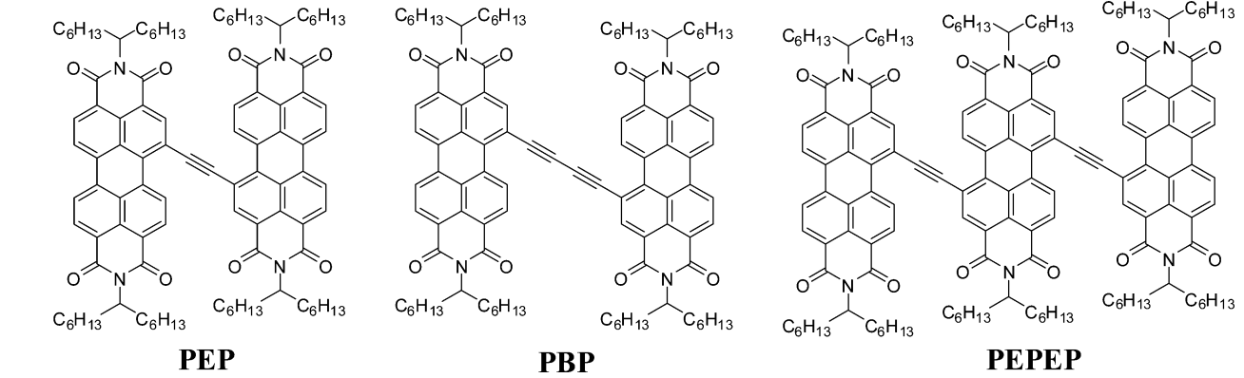
Conjugated Systems
More conjugation = longer wavelength absorbed
Cho, J., Yoo, H., Lee, J., Yan, Q., Zhao, D., Kim, D. J. Phys. Chem. Lett., 2014. 5(21), 3895-3901

Slide 5
Physical properties of Red 40, Blue 1, and Yellow 5.
FD&C Dye | Molecular Weight (g·mol⁻¹) | λ_{max} (nm) | Molar absorptivity (L·mol⁻¹· cm⁻¹)
Red 40 | 496.42 | 505 | 25023
Blue 1 | 791.84 | 630 | 105431
Yellow 5 | 534.30 | 429 | 21208

Slide 6
What is an FD&C dye?
Why quantify them?
How to quantify
Results

Slide 7
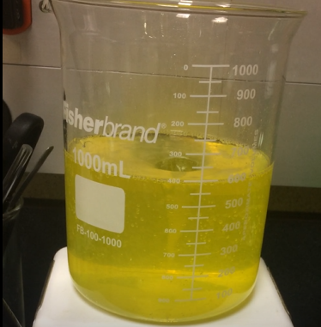
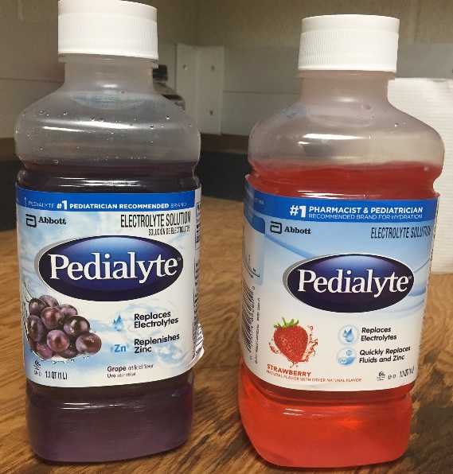
Are they safe?
“Generally recognized as safe” by the FDA
Allergic reactions
Attention deficit
Cancer?
Aungst, J. Background Document for the Food Advisory Committee. 2011.

Slide 8
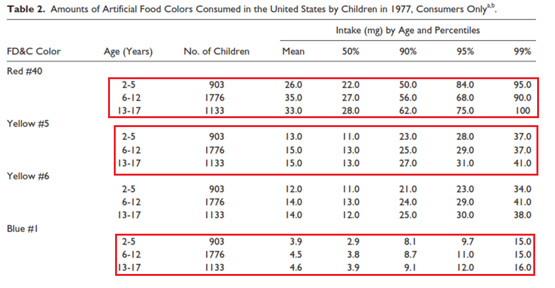
How much do Americans consume?
Batada, A., & Jacobson, M. F. Clinical Pediatrics. 2016, 55(12), 1113-1119.

Slide 9
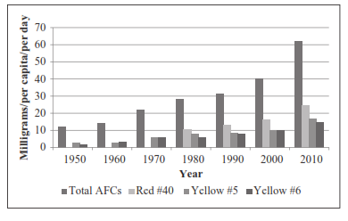
Batada, A., & Jacobson, M. F. Clinical Pediatrics. 2016, 55(12), 1113-1119.

Slide 10
What is an FD&C dye?
Why quantify them?
How to quantify
Results

Slide 11
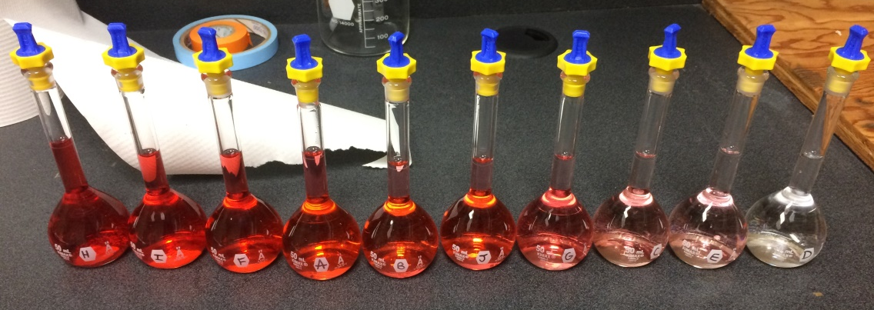
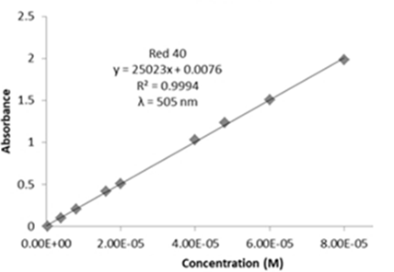

Experimental
Calibration curve and Beer’s Law
$$A=εbc$$

Slide 12
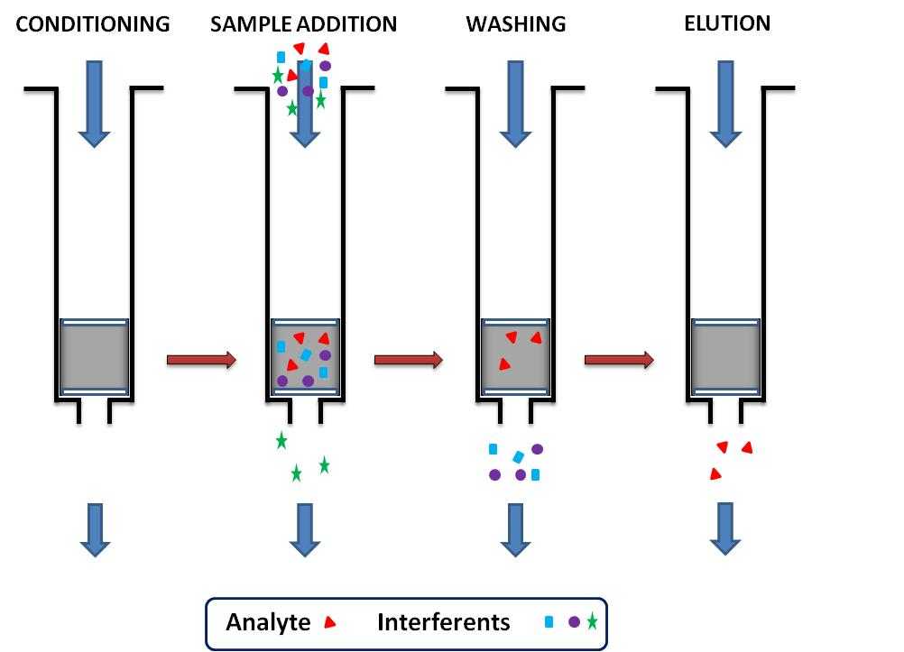
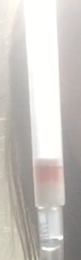
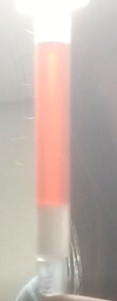
Experimental
Need to make sure nothing other than the dye absorbs at λ_{max}
Alkarawi, D. Western Kentucky University. 2016.

Slide 13
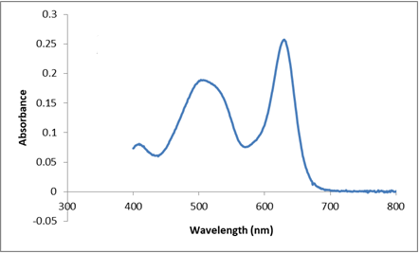
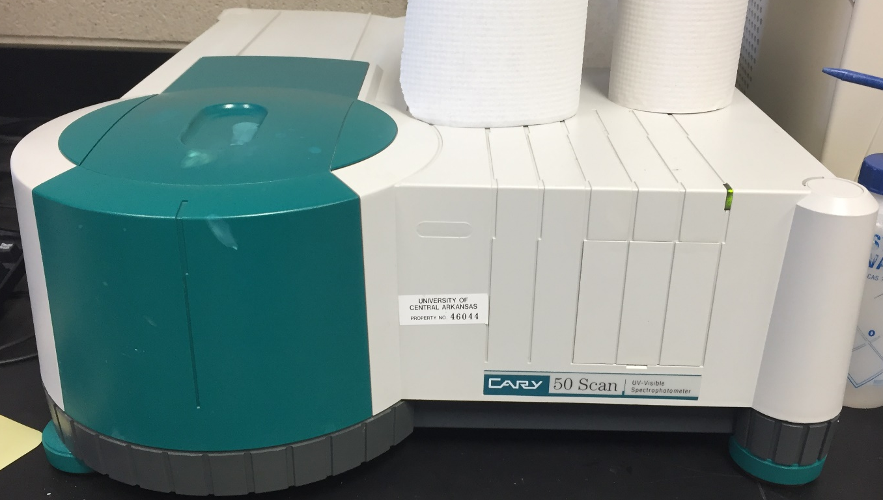
Experimental
UV-Visible Spectrophotometer

Slide 14
Analysis
Absorbances are additive

Slide 15

Analysis
Two equations two unknowns
$$A_{B1}=A_{630}−{0.0462A}_{R40}$$
$A_{R40}=A_{505}−{0.00670A}_{B1}$
 | 630 nm | 505 nm | 429 nm
Blue 1 | 1.00 | 0.00670 | 0.0219
Red 40 | 0.0462 | 1.00 | 0.291
Yellow 5 | 0.00604 | 0.00 | 1.00

Slide 16
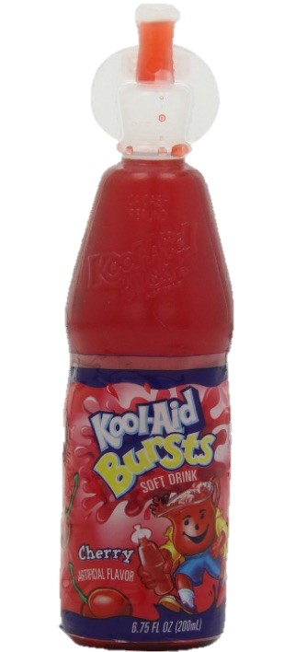
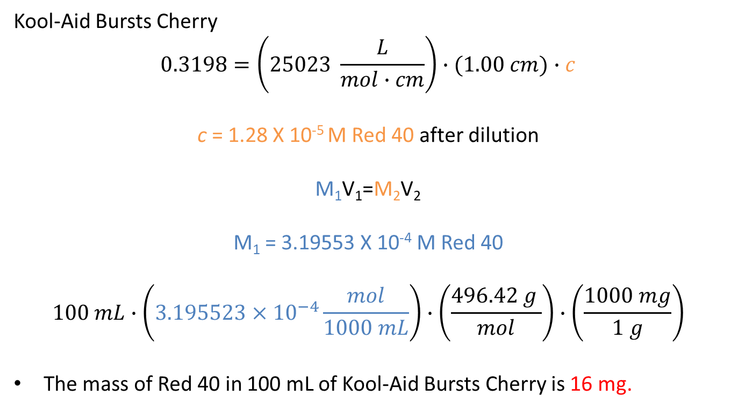
Calculations
Kool-Aid Bursts Cherry
$$0.3198=\left(25023 \frac{L}{mol∙cm}\right)∙(1.00 cm)∙c$$
c = 1.28 X 10⁻⁵ M Red 40 after dilution
M₁V₁=M₂V₂
M₁ = 3.19553 X 10⁻⁴ M Red 40
$$100 mL∙\left(3.195523×{10}^{−4}\frac{mol}{1000 mL}\right)∙\left(\frac{496.42 g }{mol}\right)∙\left(\frac{1000 mg}{1 g}\right)$$
The mass of Red 40 in 100 mL of Kool-Aid Bursts Cherry is 16 mg.

Slide 17
What is an FD&C dye?
Why quantify them?
How to quantify
Results

Slide 18
Sample | Blue 1 (mg) | Red 40 (mg) | Yellow 5 (mg)
Kool Aid Jammers Grape | 0.044 | 0.11 | -
Gatorade G2 Grape | 0.67 | 1.2 | -
Gatorade G2 Fruit Punch | - | 15 | -
Gatorade Tropical Cooler | 0.92 | - | 25
Gatorade Icy Charge | 0.71 | - | -
Powerade Twisted Blackberry | 0.14 | 45 | -
Powerade Fruit Punch | - | 48 | -
Powerade Lemon Lime | - | - | 69
Powerade Mountain Berry Blast | 3.0 | - | -
Kool Aid Bursts Fruit Punch | - | 15 | -
Kool Aid Bursts Grape | 1.3 | 3.2 | -
Kool Aid Bursts Cherry | - | 32 | -
Kool Aid Grape Powder | 1.2 | 3.3 | -
Kool Aid Tropical Punch Powder | - | 16 | -
Hawaiian Punch Fruit Juicy Red | - | 22 | -
Mountain Dew | - | - | 6.1
Pedialyte Grape | 0.22 | 0.73 | -
Pedialyte Strawberry | 0.012 | 2.1 | -
Nyquil Children’s Cold & Cough Cherry | - | 7.0 | -

Slide 19
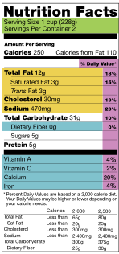
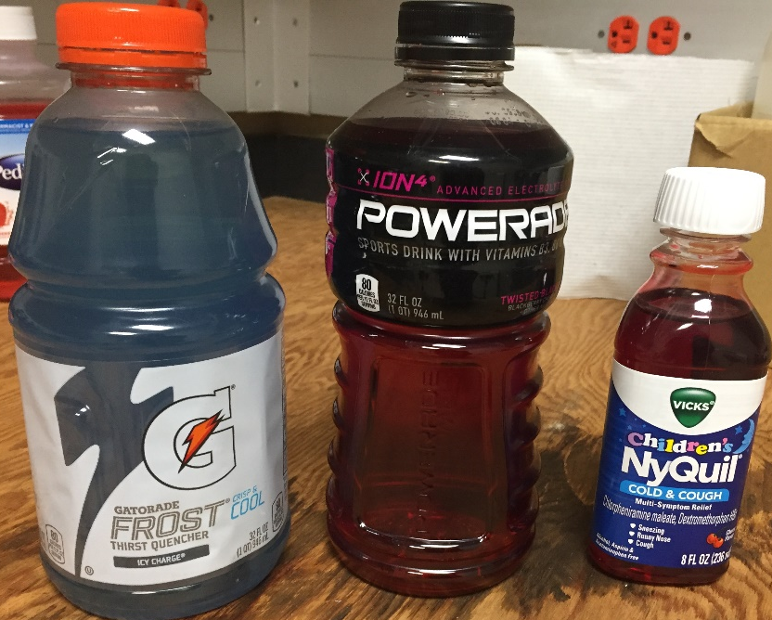
This information should be provided!
Recommended limits of each dye (per day/kg)
7 mg of Red 40
6 mg of Blue 1
7.5 mg of Yellow 5

Slide 20

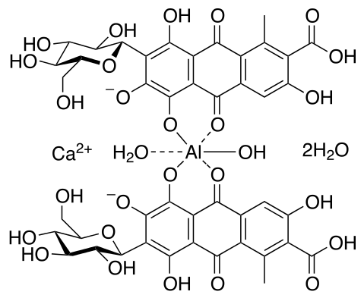
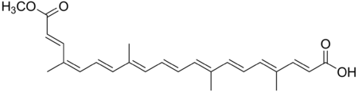
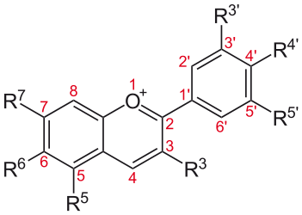
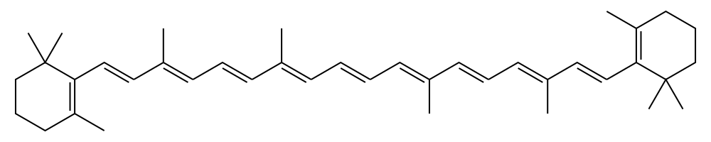
Conclusion
Should we ban artificial food dyes?
Are there alternatives?
Notes:
Annatto, anthocyanin, beta-carotene, carmine

